Slide 1
White Pine Scoping Notice Public Meeting
May 2, 2019

Slide 2
Chattooga Conservancy
Goals:
Monitor the U.S. Forest Service’s management of national forest lands in the Chattooga watershed
Educate the public
Promote public choice based on credible scientific information
Work cooperatively to develop a sound ecosystem initiative for the watershed
Promote public land acquisition by the Forest Service within the watershed
Protect remaining old growth and roadless areas
Promote sustainable communities
Promote conservation by honoring cultural heritage
Our mission is to…
Protect, promote, and restore the natural ecological integrity of the Chattooga River watershed ecosystems;
Ensure the viability of native species in harmony with the need for a healthy human environment; and
Educate and empower communities to practice good stewardship on public and private lands

Slide 3
Scoping Notice: Overview
Purpose:
“Change forest conditions from evenly-spaced white pine dominated plantations to more diverse mixed species stands that are ecologically suited to the site”
Improve ecosystem health
Increase diversity of habitat
Photo: A white pine plantation on Turkey Ridge Road

Slide 4
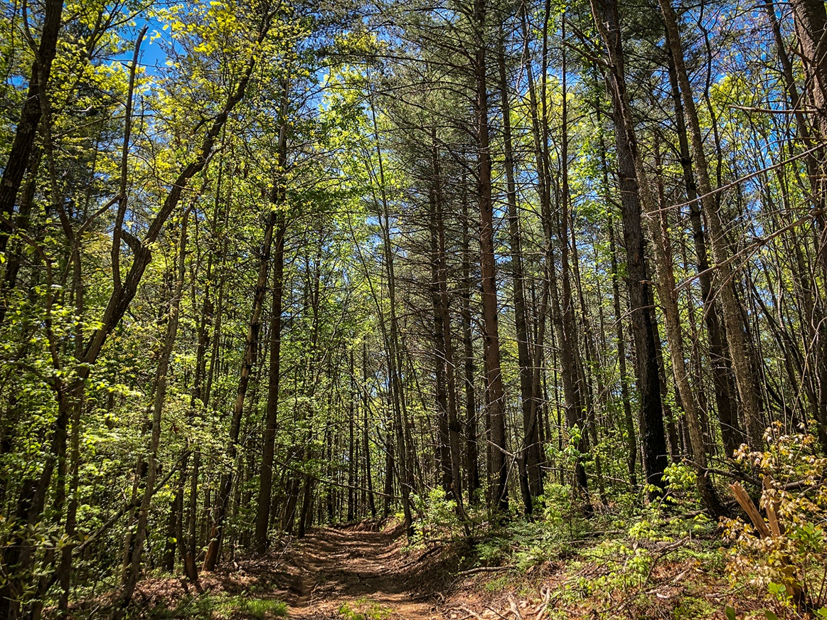
Scoping Notice: Overview
Scope
2,148 acres total, 66 stands
1,467 acres: Even-age harvests of clear-cuts “with reserves”
661 acres: Uneven-age harvests of group selections and thinning
Forest Service roads
10 miles temporary roads
Installation of aquatic organism passages proposed at 6 locations where roads cross streams
Follow-up treatments including herbicide, prescribed burning, mastication, and/or planting
Regeneration: Planting shortleaf, pitch and/or table mtn. pine on 12 x 12 spacing, and hardwood stump sprouts

Slide 5
Why are we concerned?

Slide 6
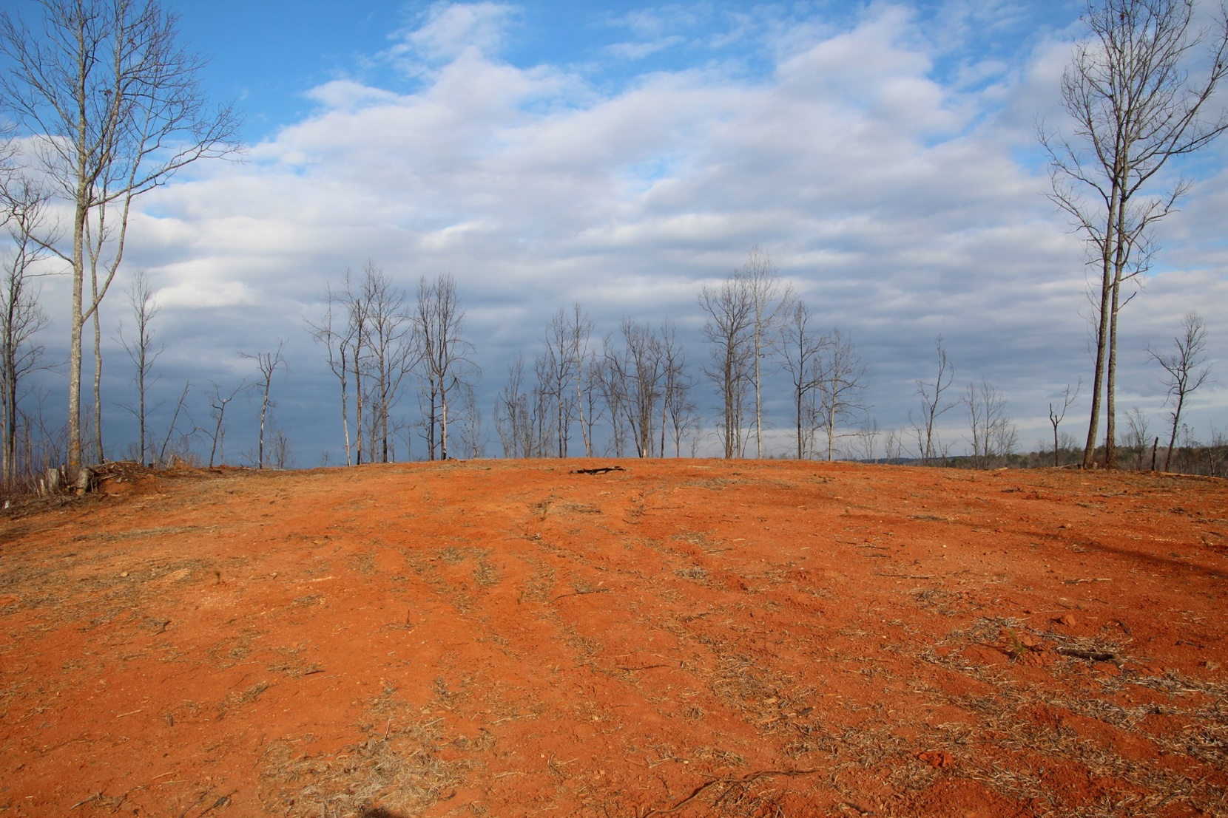
“If logging looks bad, it is bad. If a forest appears to be mismanaged, it is mismanaged.” - Gordon Robinson, Forester
Loblolly Pine removal on Turkey Ridge Rd.

Slide 7
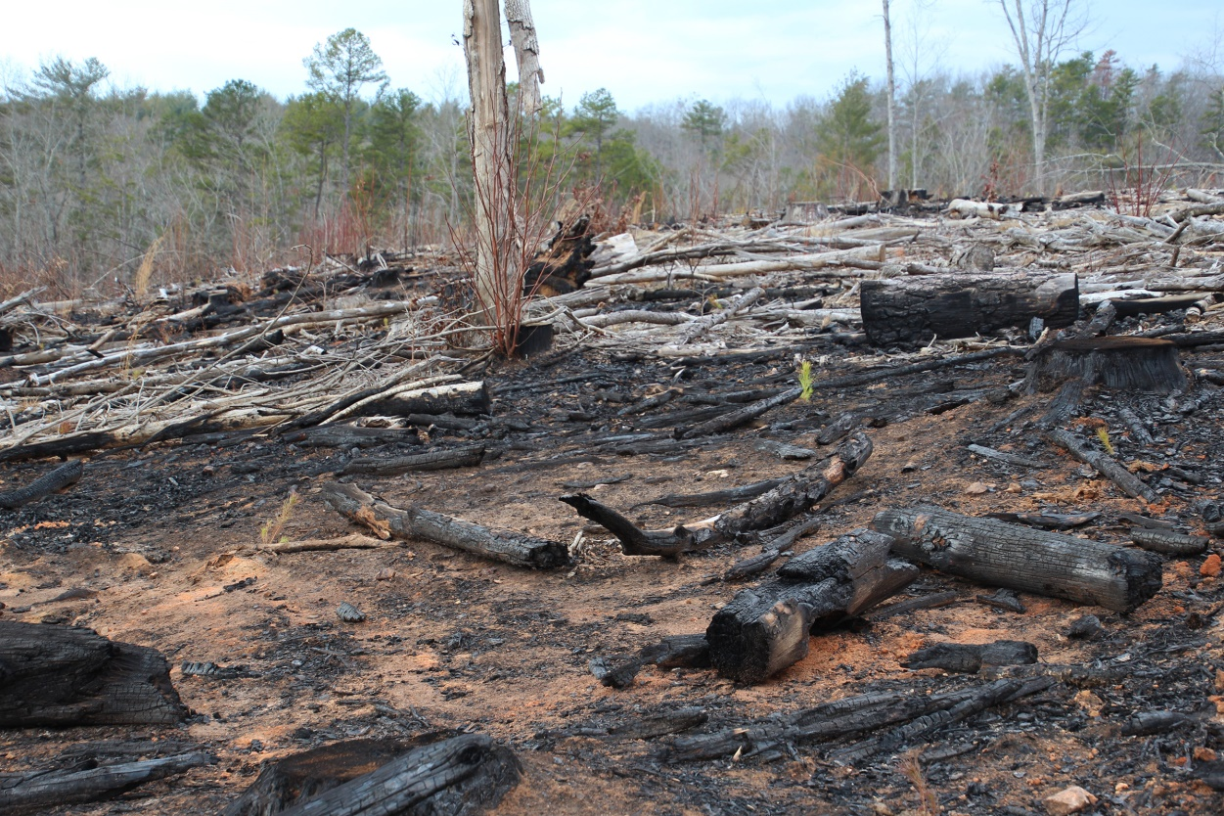
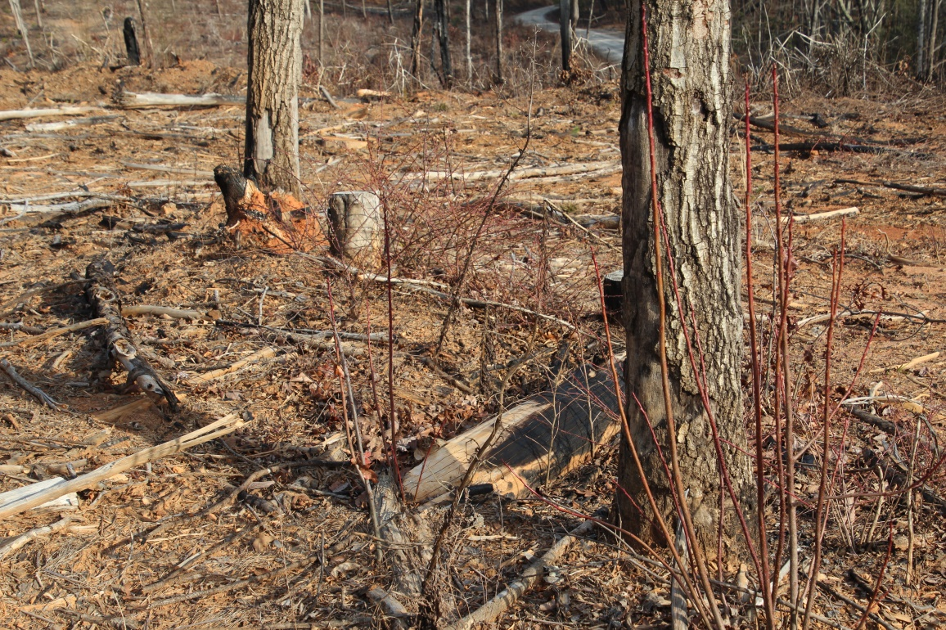
More Turkey Ridge Road
Photos c/o Amanda Gladys

Slide 8
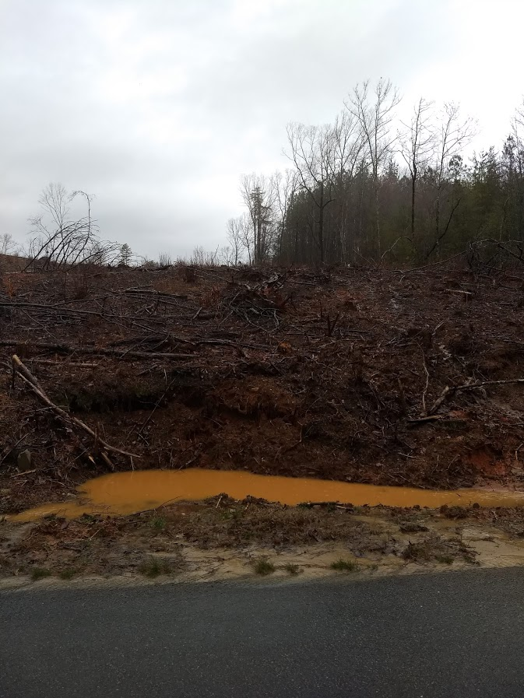
Erosion & Sedimentation Issues Charlie Cobb Road

Slide 9
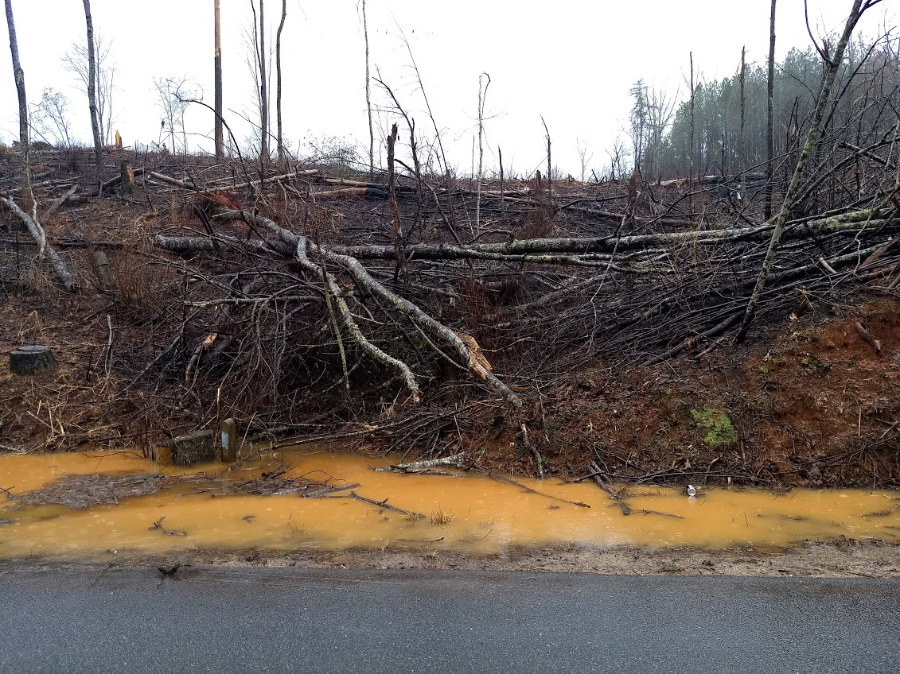
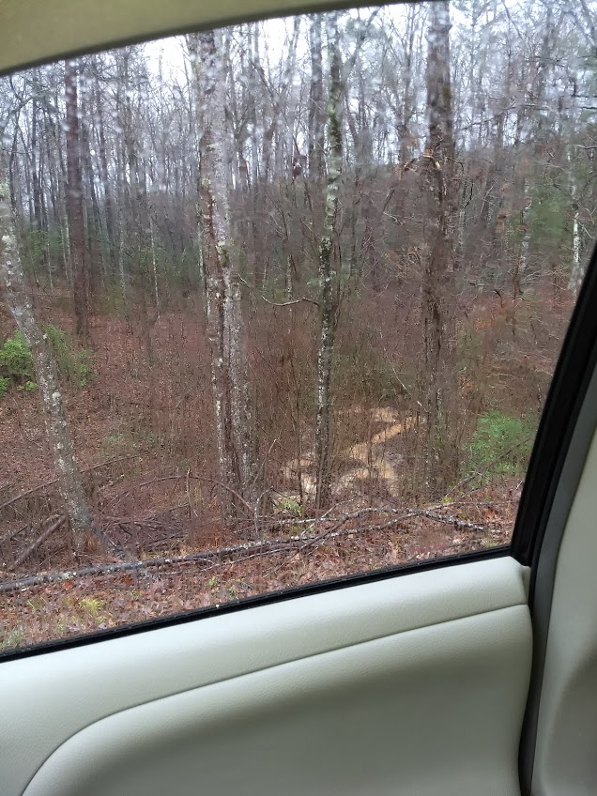
Charlie Cobb Road
Photos c/o Chanda Morrison

Slide 10
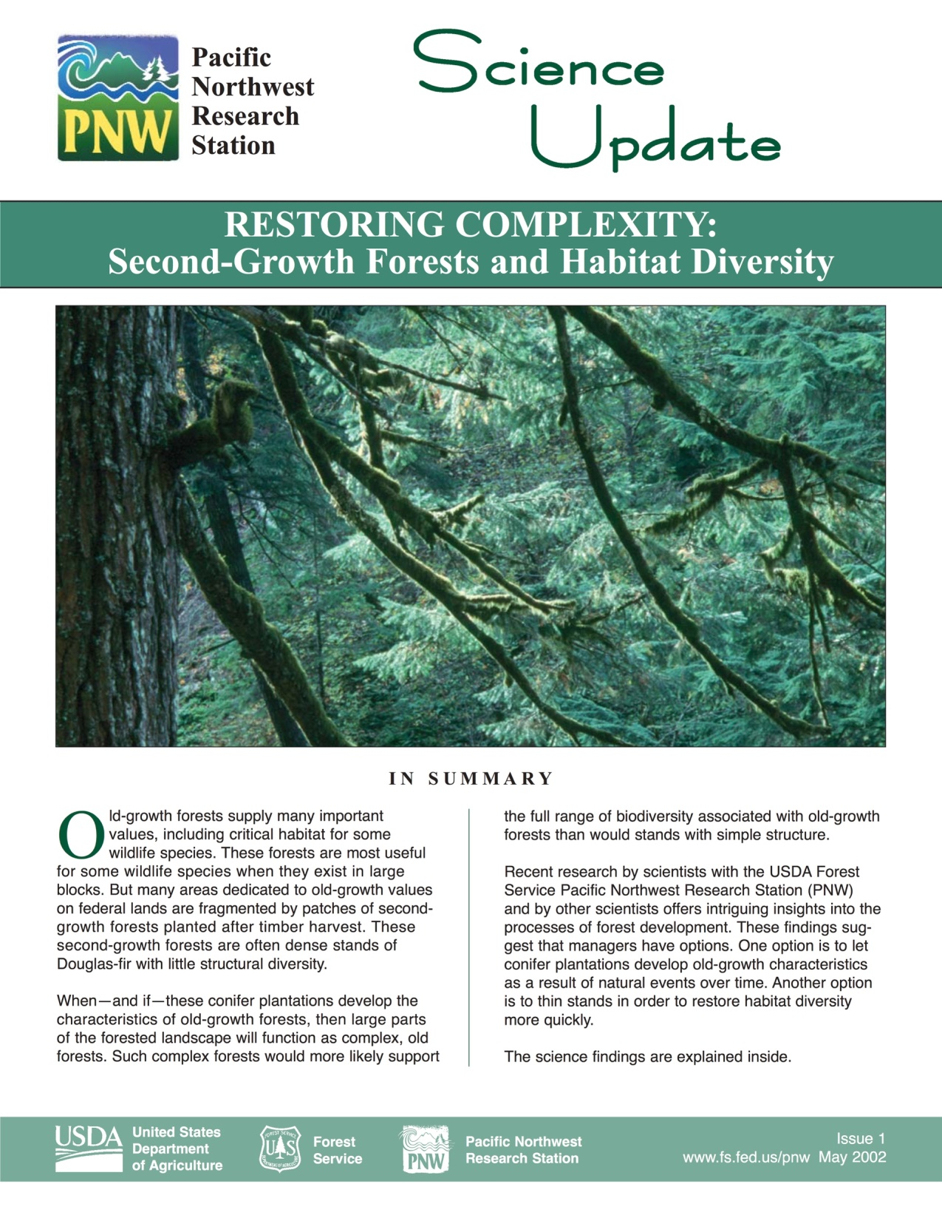
Use of Outdated Science Recent studies conducted by scientists at the Forest Service’s Pacific Northwest Research Station suggest that the best way to manage pine plantations is to use thinning harvests, and/or benign neglect.

Slide 11
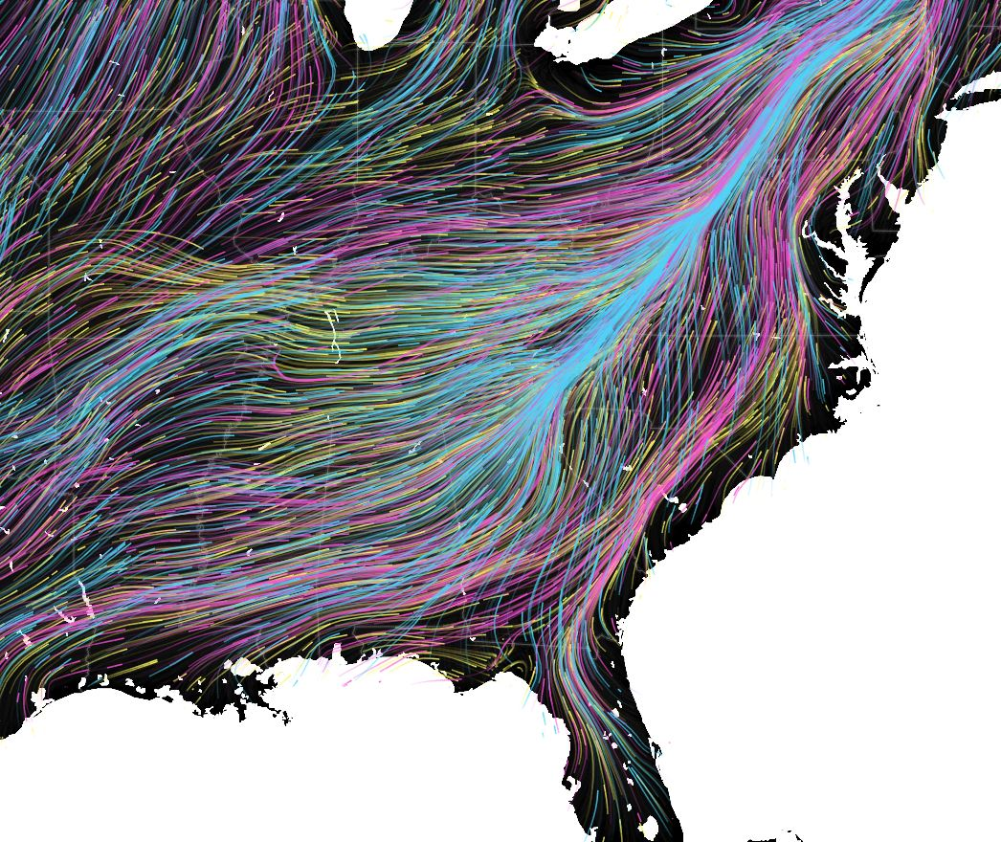
Chattooga Watershed: Biological Diversity Hotspot
Link: Migrations in Motion

Slide 12
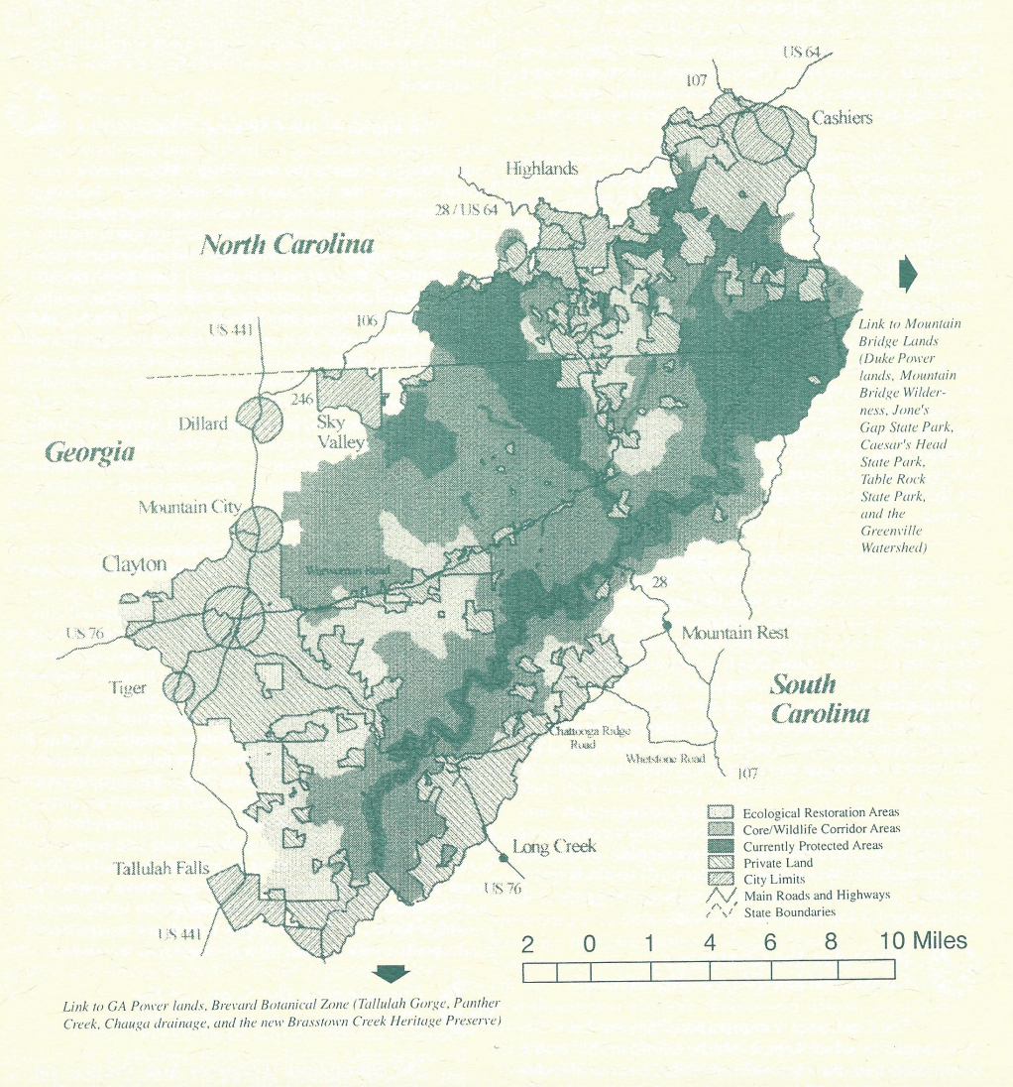
Chattooga Conservation Plan

Slide 13
Bailey’s Ecological Land Classification
M221: The Chattooga River Watershed lies in the Central Appalachian
Broadleaf Forest

Slide 14
“In making harvest cuts of timber of rotation age, substantial economics in logging costs can be made through use of mechanized equipment, especially in the case of clearcutting, applied fairly uniformly over substantial areas.”
- Forest Management by Kenneth Davis (Silvicultural methods)

Slide 15
Sumter Forest Plan Guidelines
Sumter National Forest Land Management Plan,
p. 2-17, Goal 18, FW-54

Slide 16
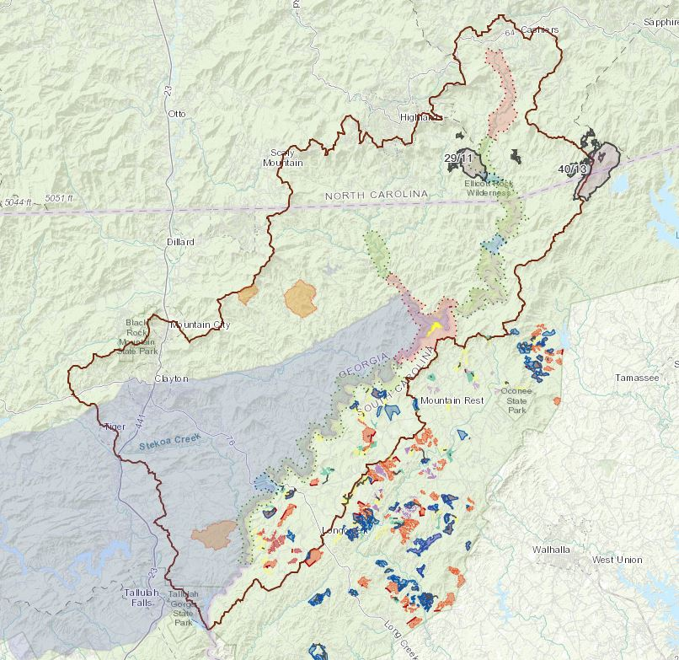
Interactive Map
Link: CHATTOOGARIVER.ORG/MAP

Slide 17
Our Recommendations
Thinning
Can accelerate native forest regeneration
Where: Only locations where roads already exist and where critical habitat would not be harmed
Benign neglect
Leave the trees alone and let nature heal itself
Where: Areas near old growth and near the Chattooga Wild & Scenic Corridor; areas with steep slopes; areas that would require extreme and/or damaging road-building.
John Mountain at Swafford Creek, Sandy Ford, and Round Mountain should be amended; potentially other areas as well.

Slide 18
How to Get Involved
The public owns our national forests
Email: comments-southern-francismarion-sumter-andrewpickens@fs.fed.us
Mail: District Ranger 112 Andrew Pickens Circle Mountain Rest, SC 29664
Submit comments by May 8th, 2019

